Slide 1

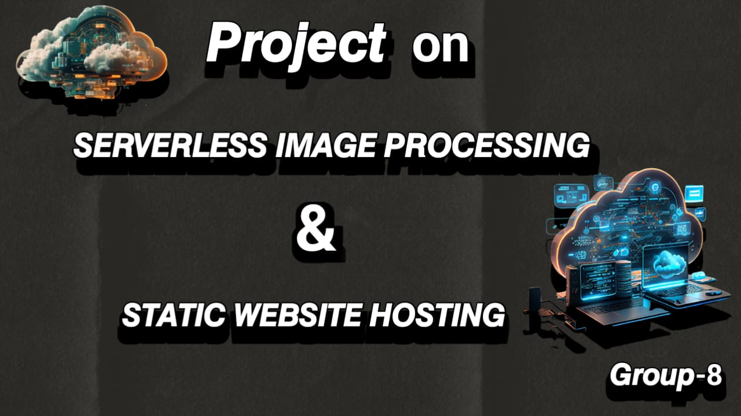

Slide 2



SERVERLESS IMAGE PROCESSING
PROJECT 1
Create a server-less image processing application that automatically resizes and optimizes images

Slide 3
TABLE OF CONTENT
INTRODUCTION
S3 BUCKETS
IAM ROLES
LAMBADA FUNCTION & CODE PROPERTIES
TESTING

Slide 4
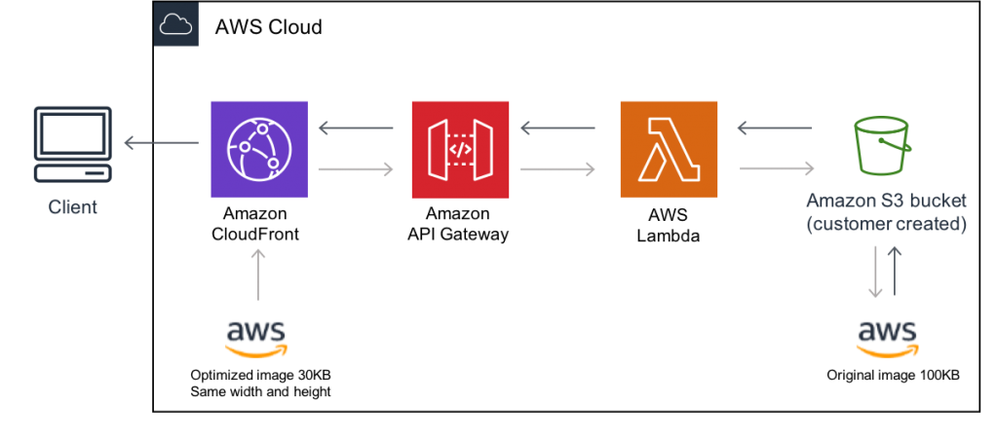
INTRODUCTION
This solution creates a server-less architecture to initiate cost-effective image processing in the AWS Cloud. The architecture combines AWS services with sharp open-source image processing software and is optimized for dynamic image manipulation. You can use this solution to help you maintain high-quality images on your websites and mobile applications to drive user engagement.

Slide 5
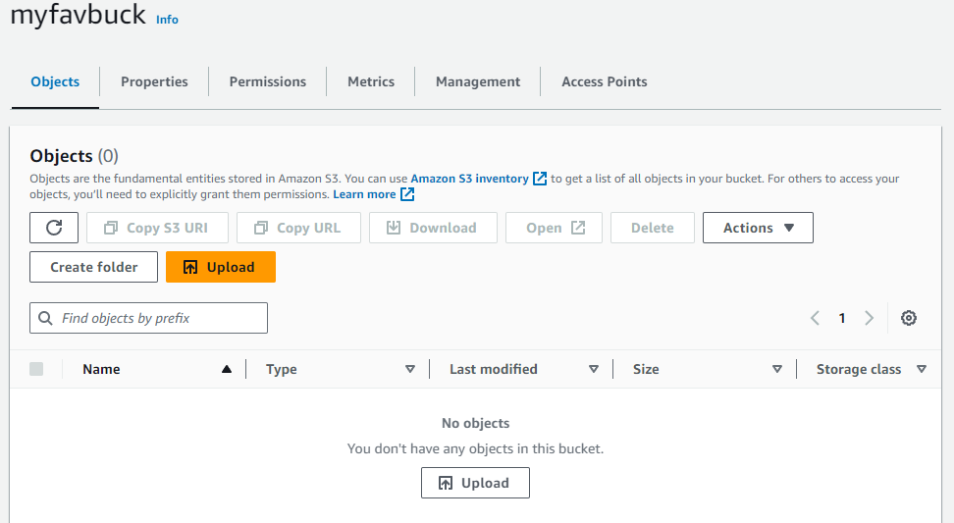
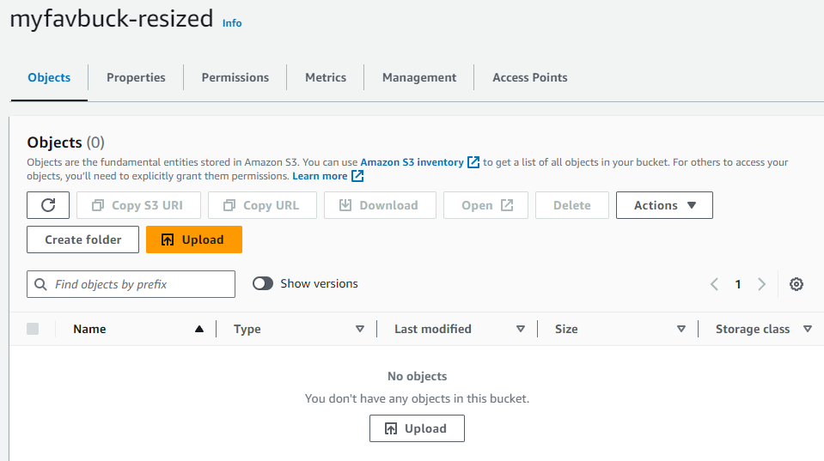
S3 BUCKET
Create two buckets ( source & destination )
Region-up-west-2 Northern Virginia
Make destination bucket with “-resized”
Make objects of source bucket is public
Block public access (objects) of destination bucket

Slide 6
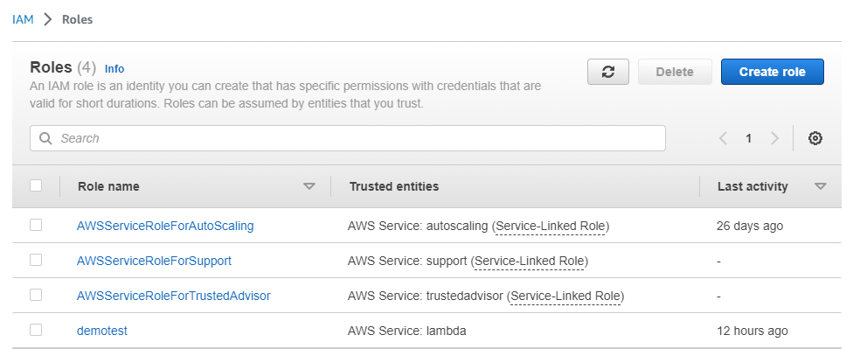
IAM ROLE
Create an IAM role ( entity type , use cases )
Attach policies ( AmazonS3-full-access , AWS-lambda_ full-access )
Give name to the role
Create role ( demo_test )

Slide 7
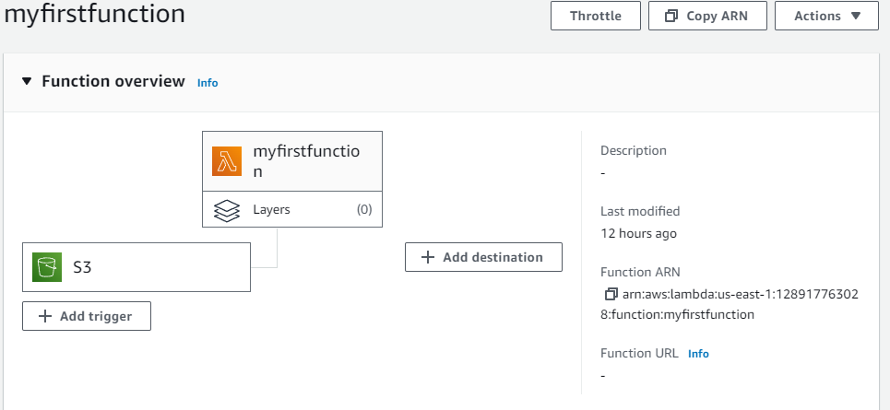
LAMBADA FUNCTION
Create lambda function ( author from scratch , architecture , role )
Add trigger ( S3 source bucket )

Slide 8
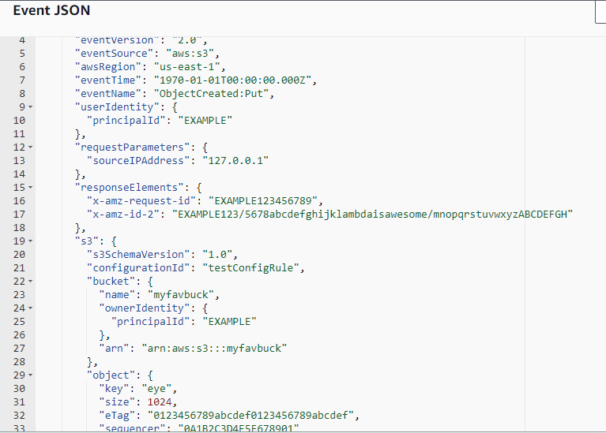
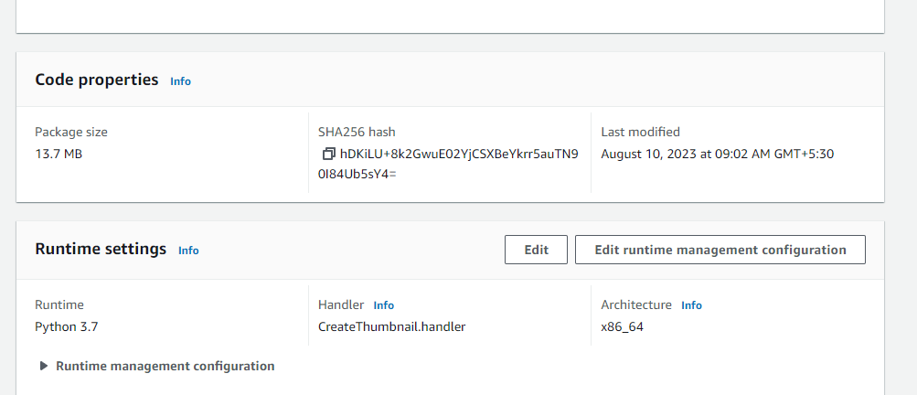
CODE PROPERTIES
Edit code properties
Upload zip file
In test tab create event and edit JSON code
Test event
07

Slide 9
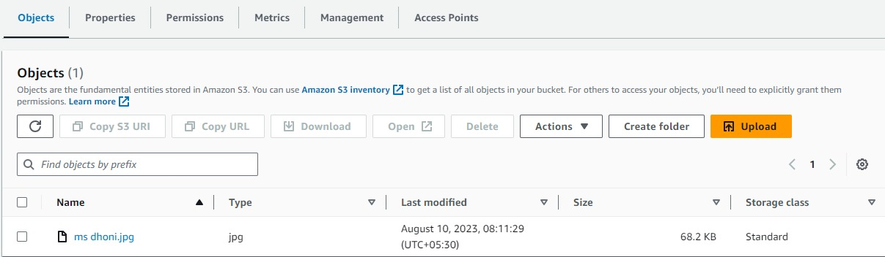
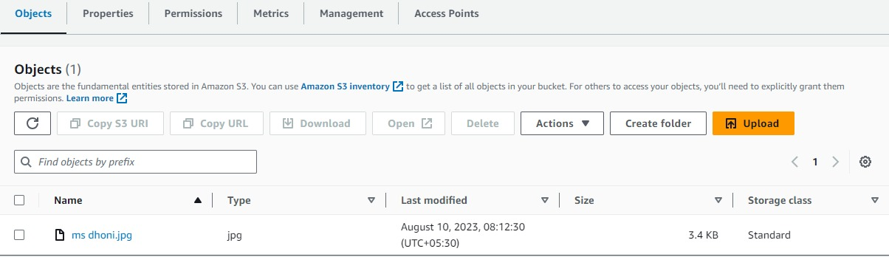
TESTING APPLICATION

Slide 10
Static Website Hosting
PROJECT 2
Create a static website and deploy it using AWS services. A static website is a site that consists of HTML, CSS, and JavaScript files, and it doesn't require server-side processing or a database

Slide 11

CONTENTS
INTRODUCTION
STEPS TO CREATE WEBSITE
SUMMARY & BENEFITS
CONCLUSION

Slide 12
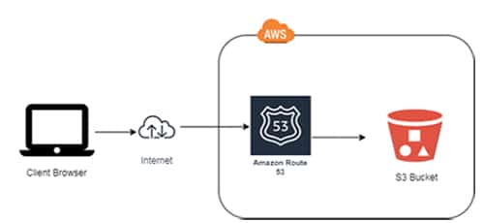
STEPS TO CREATE STATIC WEBSITE
Create an S3 Bucket
Configure The Bucket
Upload Website Content
Configure Permissions
Enable Website Endpoint

Slide 13
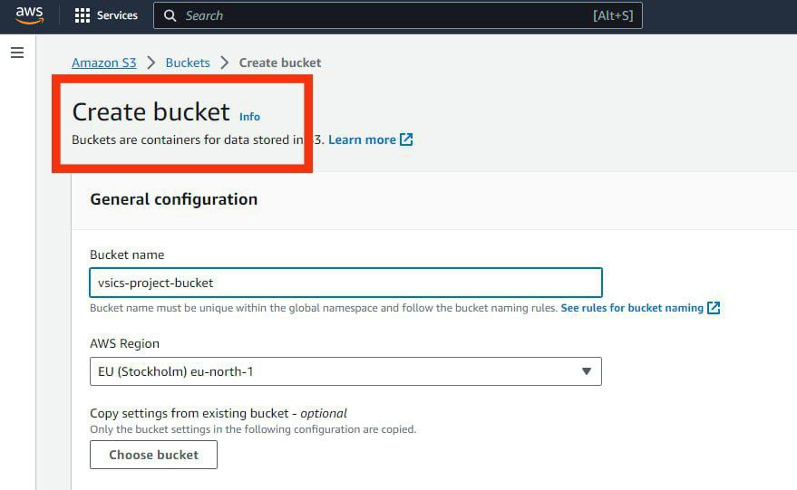
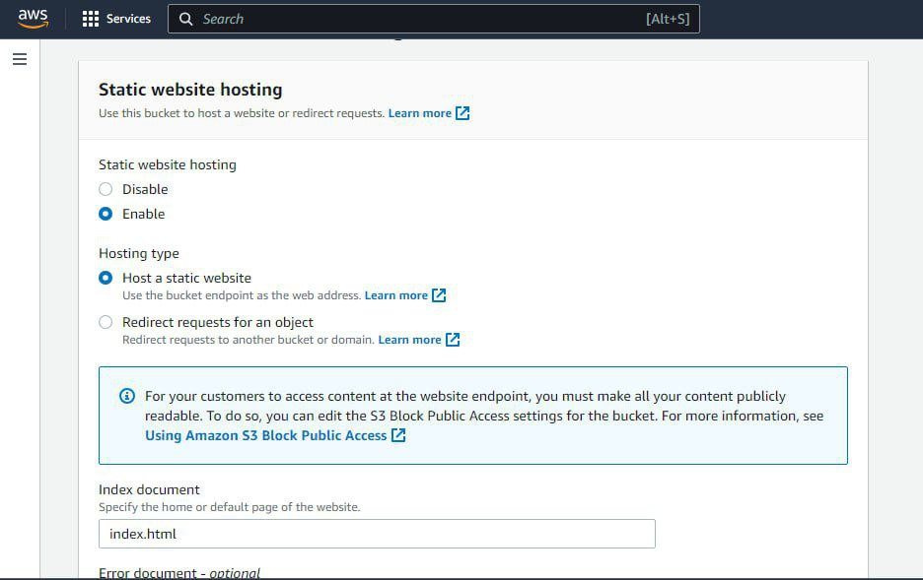
CREATION & CONFIGURATION OF BUCKET
Create an S3 bucket ( unique name )
Select region ( up east 1 Northern Virginia )
Change bucket properties
( Static Website , Hosting )
Use your bucket to host a website
Enter HTML file as index document
Save configuration

Slide 14
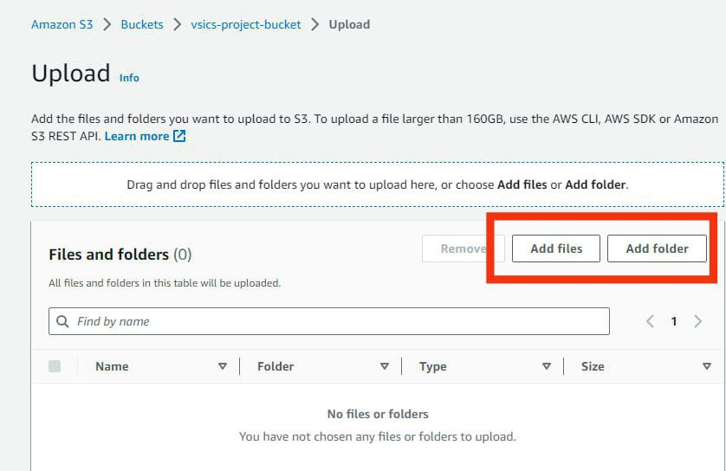
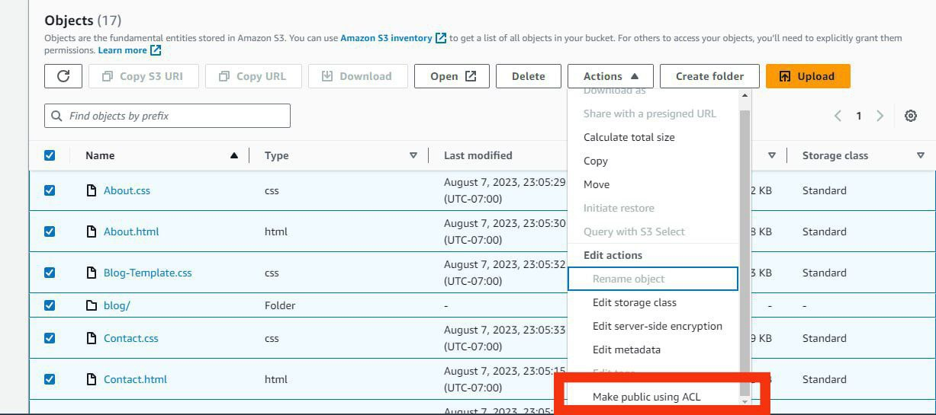
UPLOAD CONTENT & CONFIGURE PERMISSIONS
Go to S3 bucket
Upload all files
Go to ACTIONS and MAKE PUBLIC

Slide 15
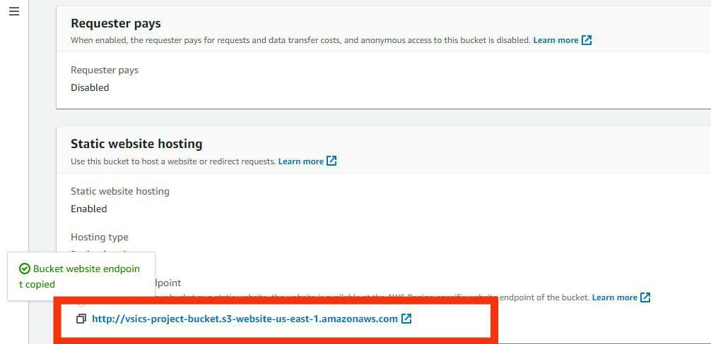
WEBSITE ENDPOINT
Enable website endpoint URL
http://your-website-name.s3-website-your-region.amazonaws.com

Slide 16
SUMMARY & BENEFITS
Static website hosting involves storing and serving web content that doesn't change, like HTML, CSS, and images, directly from a server to users' browsers.
It's cost-effective and fast since there's no need for dynamic processing. Popular services for static site hosting include GitHub Pages, Netlify, and Amazon S3.
You upload your files, and these services distribute your site globally, ensuring high availability and reduced load times.
It's easy to create, faster to load, and usually cheaper to host. Since it doesn't change often, it's also more secure.

Slide 17
THANK YOU

